Slide 1


Slide 2
Learning
Management
System
Teamwork Names
Mohammed Shaaban Ali
Hisham Mahmoud Khirallah
Mahmoud Ezzat
Noura Abd El Rahman Zakari
Sahar Gamal Tawfik
Omnia Mohammed Tawfik
Under Supervision

Slide 3
01
Abstract
02
Class Diagram
03
Activity Diagram
04
Sequence Diagram
05
State Diagram
06
Deployment Diagram
Agenda

Slide 4
Abstract
Our project is built upon a profound understanding of the challenges faced by students in technical education schools, reflecting the academic experience of general secondary school students. As fortunate recipients of easily accessible private tutoring, we embraced the principle of equal opportunities as a key driver for our project. The concept of launching a platform offering courses for technical education schools stems from this belief in the crucial importance of providing equal educational opportunities by offering specialized, high-quality educational content.
Our project aims to enhance and broaden the learning possibilities for technical education students by providing diverse courses covering various artistic fields. Through this platform, we aspire to stimulate student engagement and knowledge exchange, not only to improve their academic performance but also to foster their artistic interests and develop their future skills. Through this initiative, we seek to make a positive impact on the future of students in technical education schools by providing innovative and effective learning tools.

Slide 5
Class Diagram

Slide 6
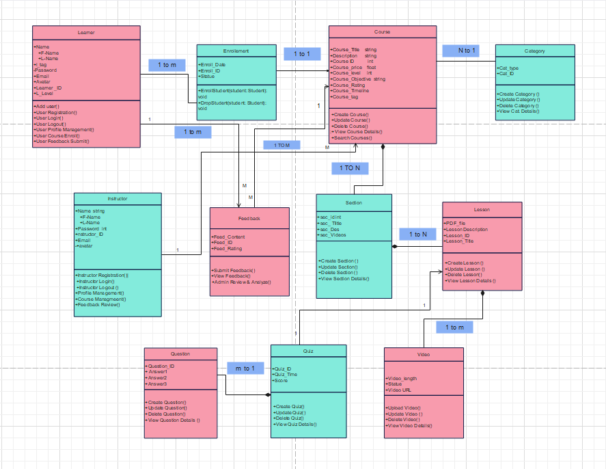

Slide 7
Activity Diagram

Slide 8
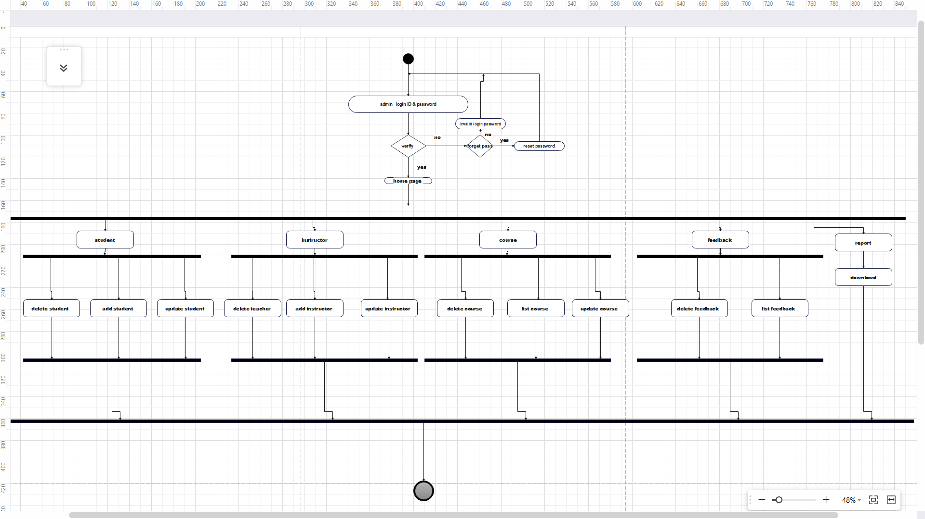

Slide 9
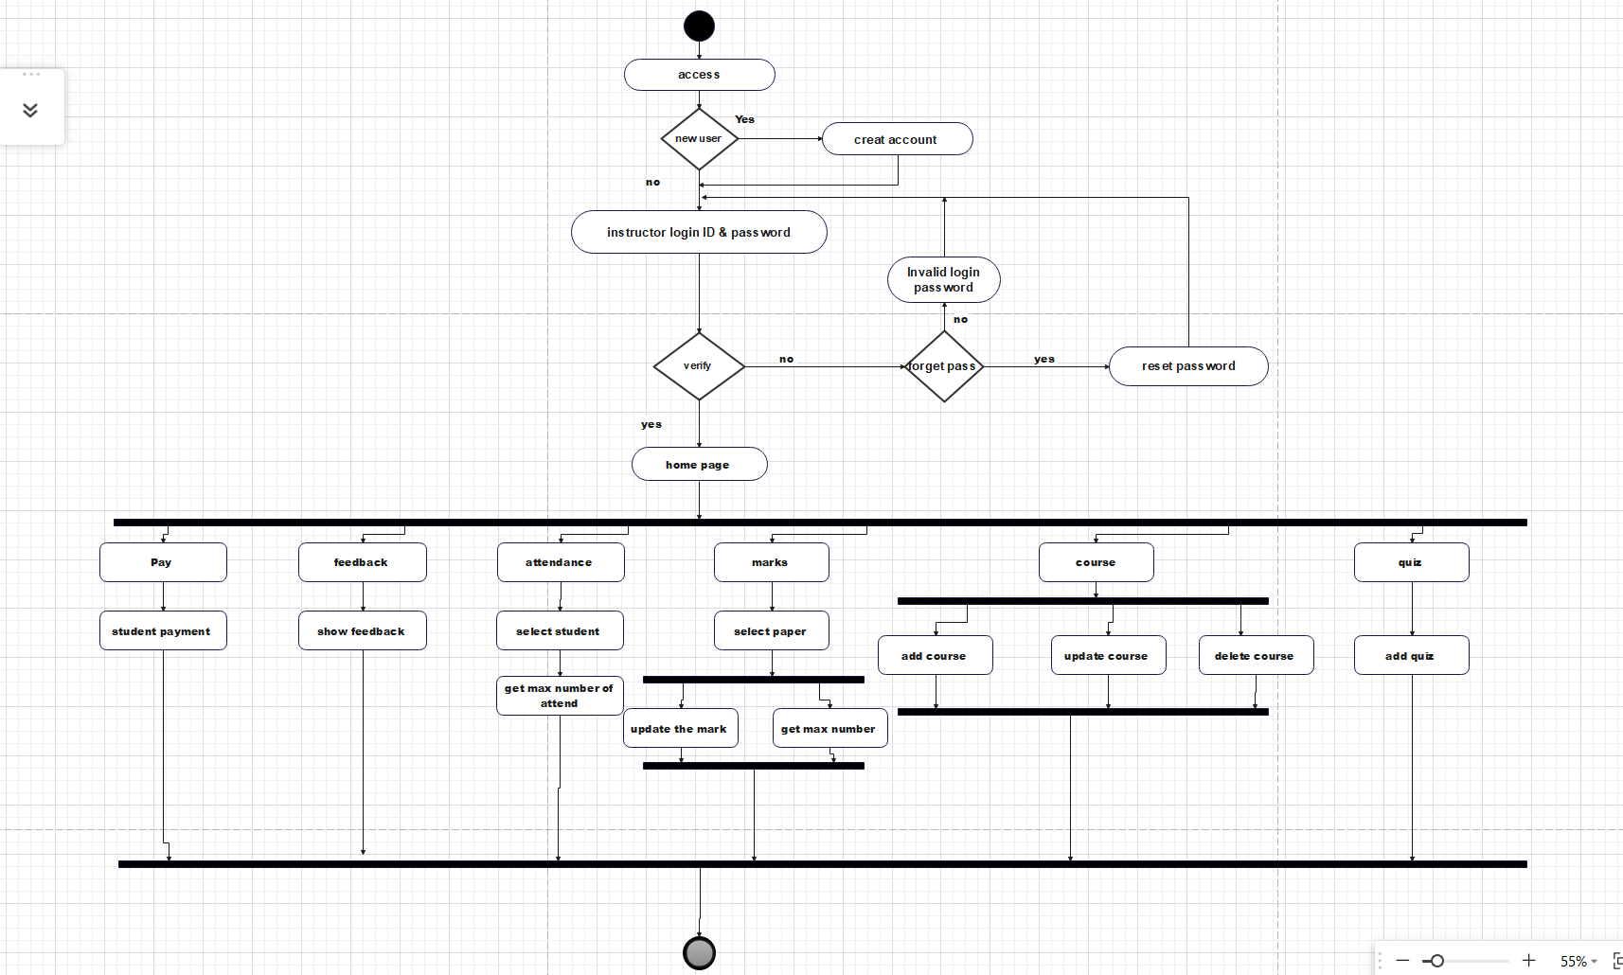

Slide 10
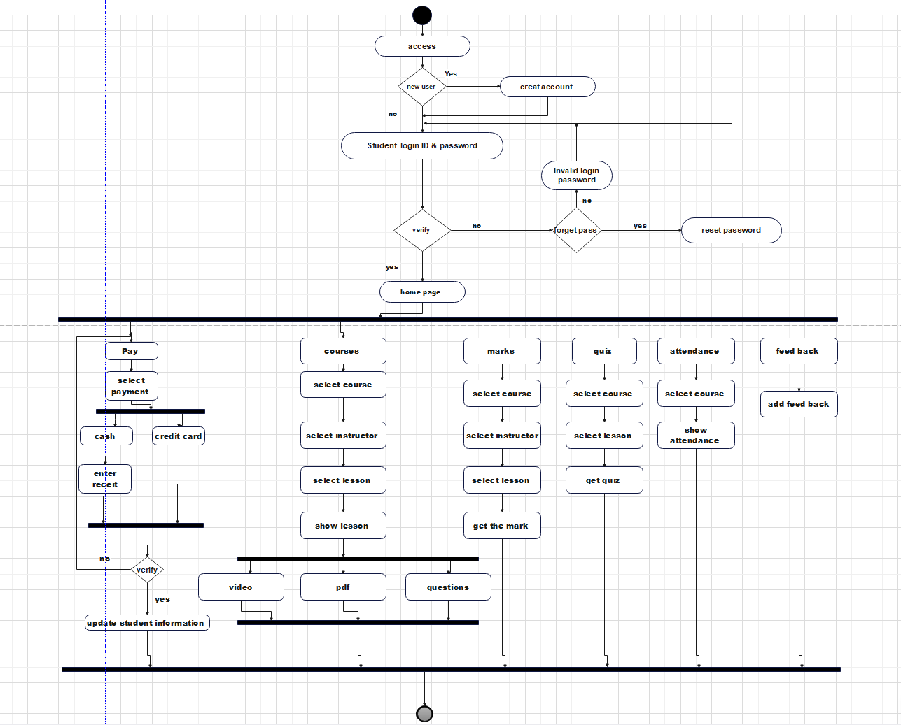

Slide 11
Sequence Diagram

Slide 12
A sequence diagram is an interaction diagram that visually represents the flow of messages and interactions between objects or entities in a system. It illustrates the chronological order of events and the exchange of messages between various elements, providing a dynamic view of the system's behavior during a specific scenario or use case.
Components :
Lifeline
Activation Box
Actor
Object
Synchronous message
Return message
object
object

Slide 13
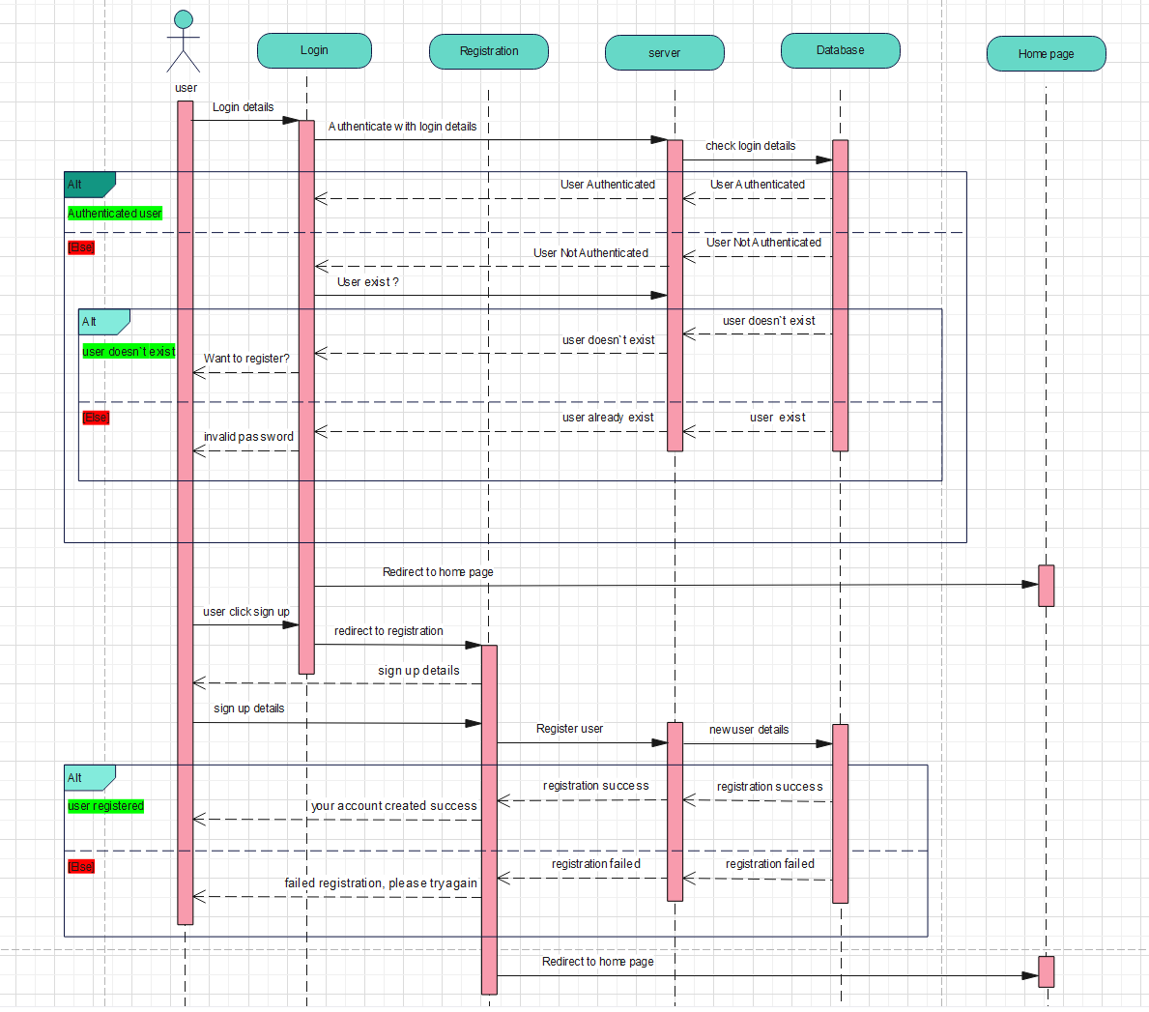
Login

Slide 14
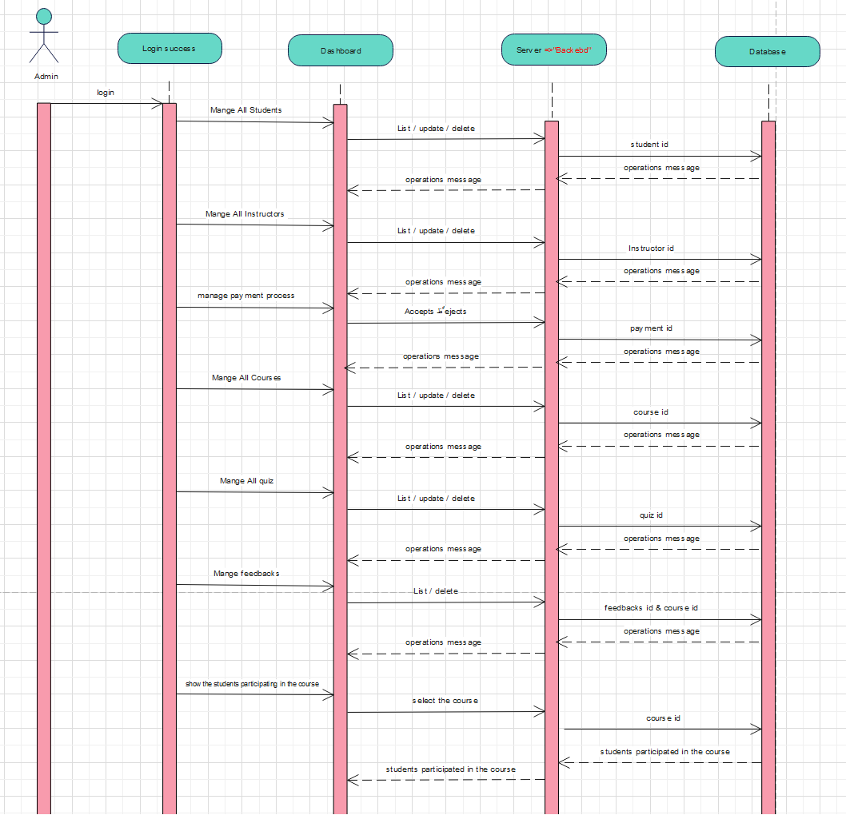
Admin

Slide 15
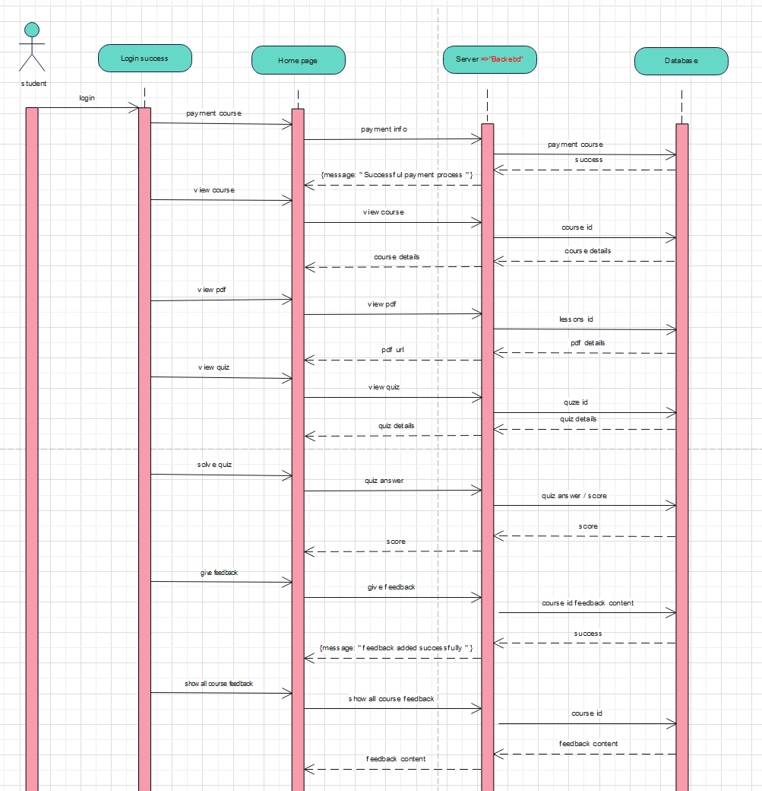
Student

Slide 16
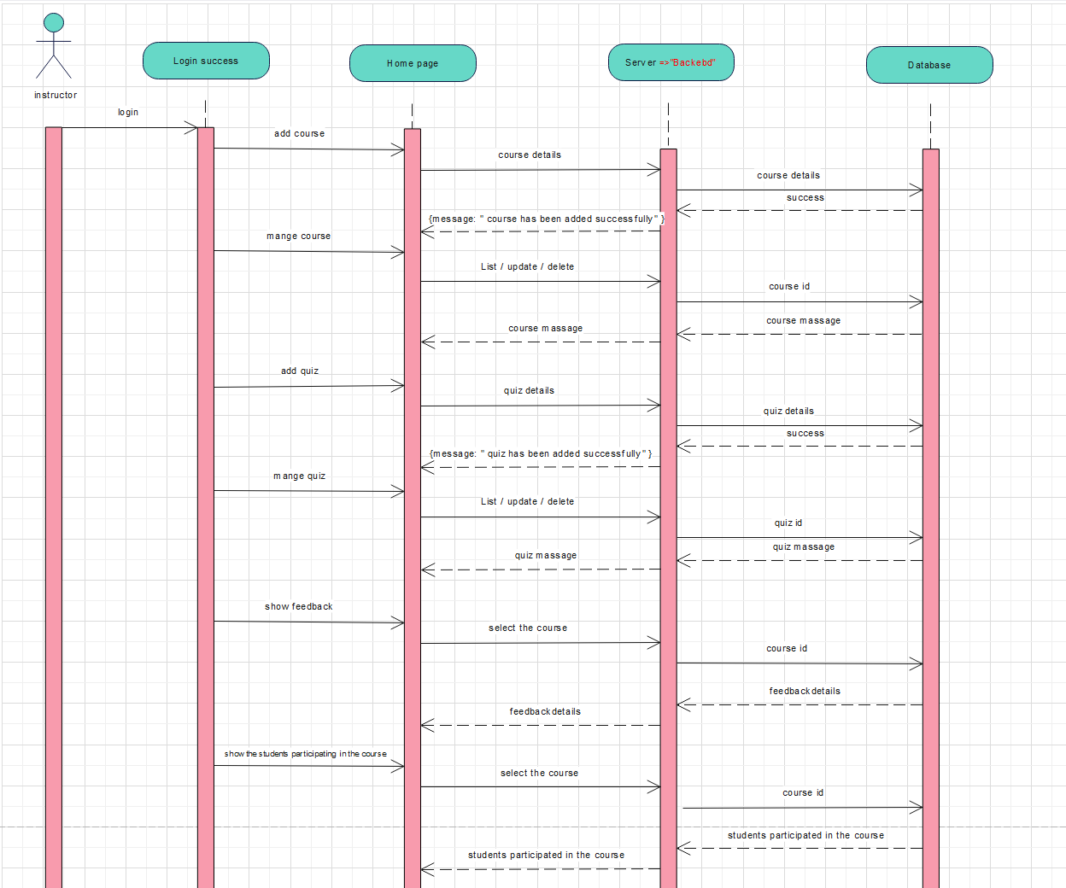
Instructor

Slide 17
State Diagram

Slide 18
A state diagram (also known as a state machine or state chart diagram) is an illustration of all the possible behavioral states a software system component may exhibit and the various state changes it's predicted to undergo over the course of its operations.
Components :
Initial state
States
State actions
Transitions
Composite state
Final state

Slide 19
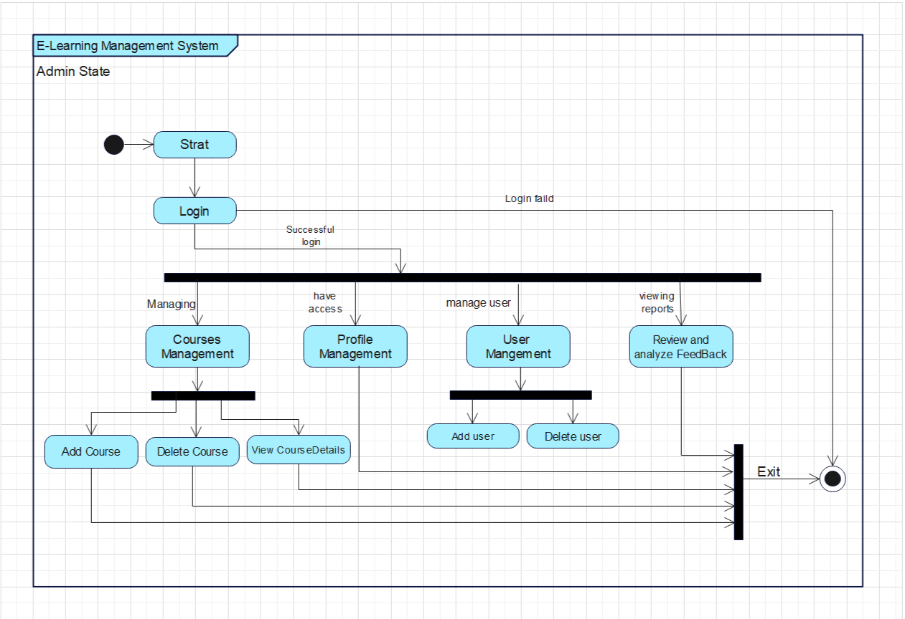

Slide 20
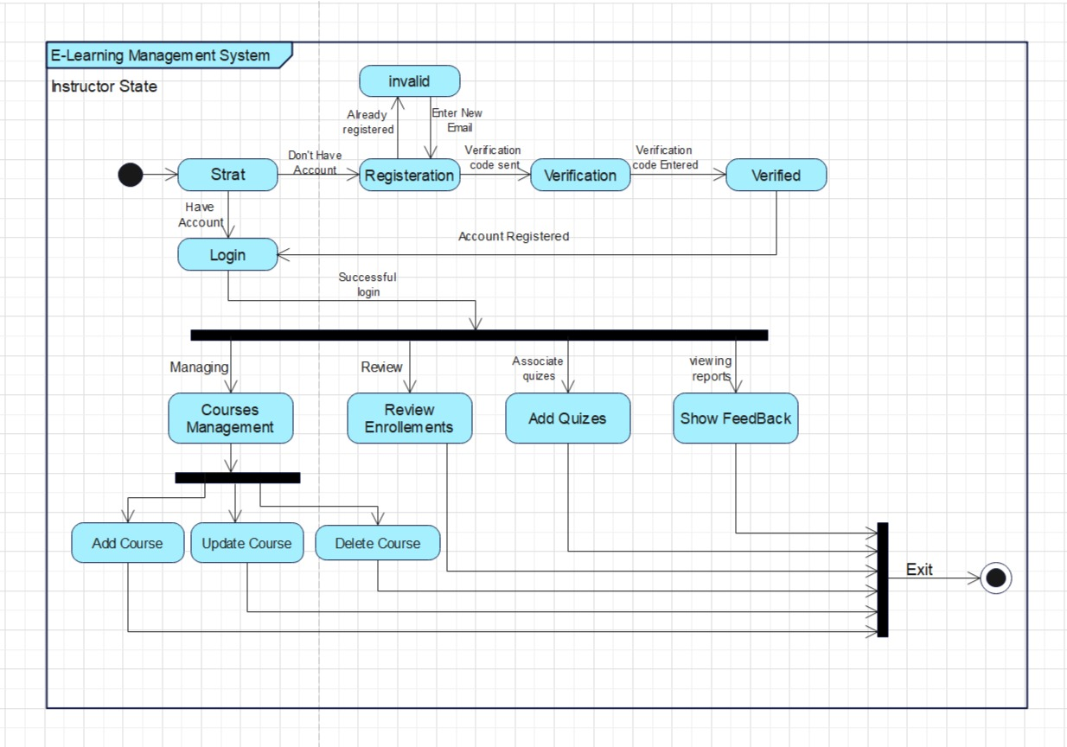

Slide 21
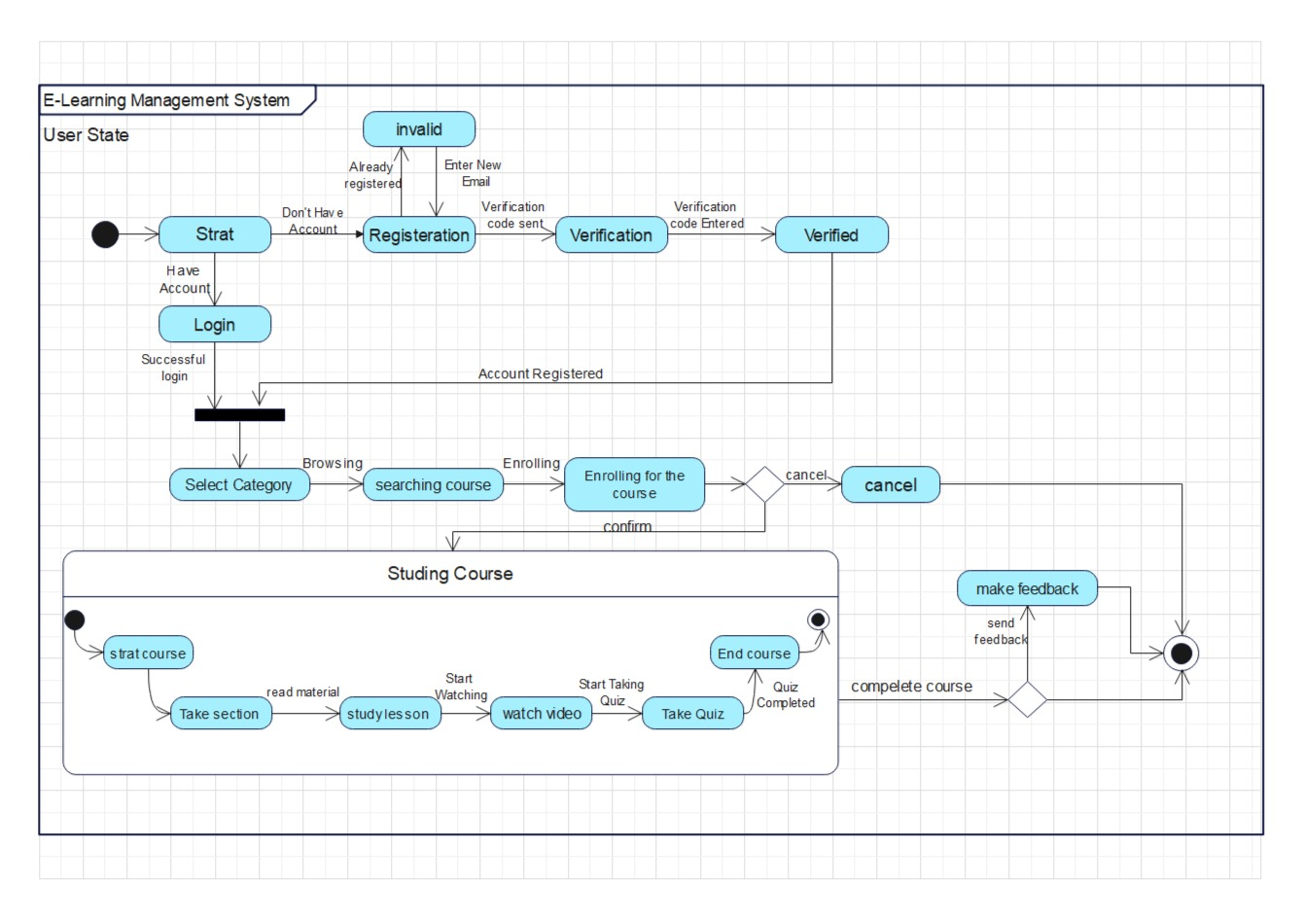

Slide 22
Deployment Diagram

Slide 23
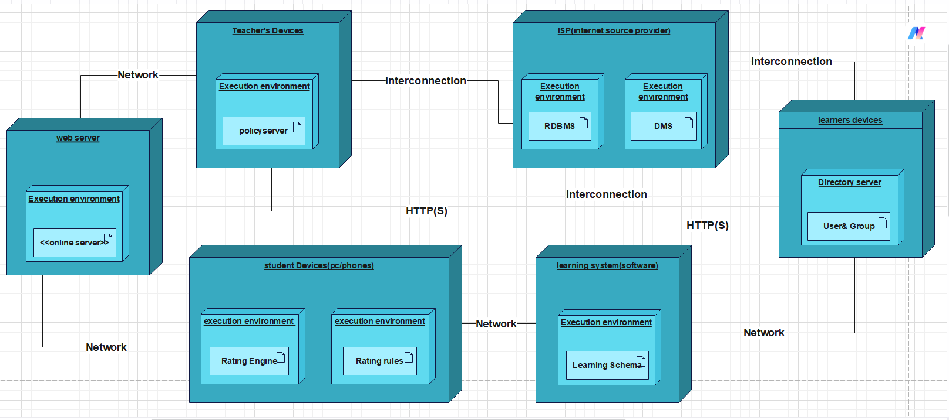

Slide 24
THANK
YOU

